Slide 1
INTELLIGENT DIABETES PREDICTION AND MANAGEMENT SYSTEM:
A COMPREHENSIVE APPROACH
Guided by:
Ms: Binu John
Assistant Professor
Department of Artificial Intelligence & Data Science
SCMS School of Engineering & Technology, Karkutty
Presented by:
Deva Deleep (22)
Gasteena Laurienda Pess (26)
Vishnu K V (55)
Vyshnavi Krishnakumar (56)

Slide 2
INTRODUCTION
The Intelligent Diabetes Prediction and Management System combines real-time health monitoring with advanced machine learning techniques to predict diabetes risk.
The system integrates real-time health data collection with advanced machine learning for diabetes prediction.
Hardware components capture vital health metrics like blood glucose, heart rate, and oxygen levels.
The mobile app processes the collected data to predict the likelihood of diabetes.
The system aims to provide a seamless healthcare experience for individuals managing diabetes.

Slide 3
OBJECTIVE
Predict the likelihood of diabetes using real-time physiological data, like Blood Glucose Level, Heart Rate, Blood Pressure, etc.
Implement a technique to analyze sequential health data for accurate predictions.
Provide users with personalized health insights, such as meal recommendations and insulin dosage based on their health data and offer real-time alerts and doctor appointment booking.
Sends real-time emergency alerts to registered phone number.

Slide 4
PROBLEM STATEMENT
To develop an IoMT-enabled real-time glucose monitoring system that leverages Bi-Directional LSTM, Edge Computing, and Polynomial Regression with the MAX30100 pulse oximetry sensor for accurate blood glucose prediction and proactive diabetes management.

Slide 5
SYSTEM DESIGN [1/8]
Predicts whether an individual is diabetic or non-diabetic based on physiological data.
The system operates independently, where the hardware component provides the readings and software components require users to manually input health data into the software.
Leverages Bidirectional LSTM for analysing sequential data and SMOTE for addressing dataset imbalance.
Connectivity using HC05 Bluetooth module.

Slide 6
SYSTEM DESIGN [2/8]
Hardware Components
Arduino Uno: Processes sensor data.
MAX30100 Sensor: Measures heart rate and oxygen saturation.
OLED Display: Shows real-time health metrics and alerts.
Power Supply: Provides power to all components.
Breadboard & Connectors: Facilitate connections and prototyping.
HC05 Bluetooth module.
Software - Mobile Application
Users manually enter values displayed on the hardware.
Predictive algorithms analyze the data for diabetes risk.
Features include:
Doctor follow-up bookings.
Meal plans with filters.
Insulin dosage.
Emergency alerts

Slide 7
SYSTEM DESIGN [3/8]
Overall Architecture
OLED
display
Measurement
site
Arduino
User manually enters value
HC-O5
Software
App
Hardware

Slide 8
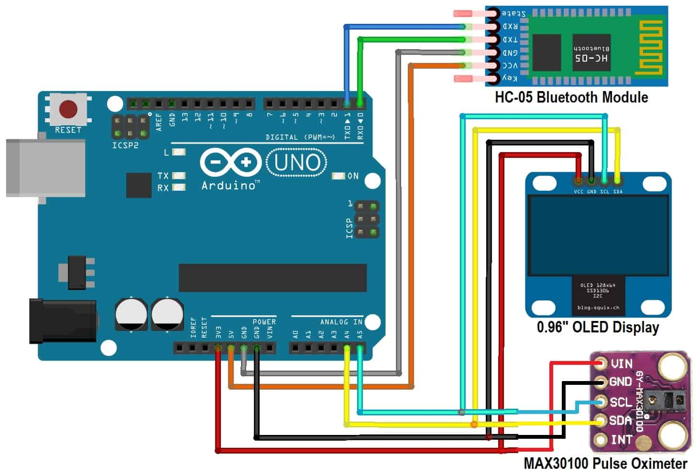
SYSTEM DESIGN [4/8]
MAX30100 Pulse Oximeter
NIR Emitter
Measurement
site
NIR Receiver
Signal Conditioning
Microcontroller
Bluetooth
HC-05 module
LCD Display
Mobile Application
how2electronics.com

Slide 9
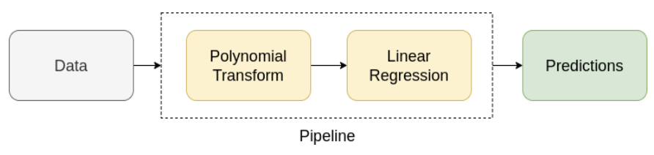
SYSTEM DESIGN [5/8]
Implementation of blood Glucose and cholesterol monitoring device using non-invasive technique
The equation used for glucose prediction is a trained second-degree polynomial regression model:
glucose_level = 16714.61 + 0.47 * bpm - 351.045 * spo2 + 1.85 * (spo2 * spo2)
This equation is derived statistically by minimizing the mean squared error (MSE). It takes BPM and SPO2 (independent variables) values from the sensor, generates polynomial features, and predicts glucose level (dependent variable).

Slide 10
SYSTEM DESIGN [6/8]
Input Features: Timestamp, Blood Glucose Level (BGL), Diastolic and Systolic Blood Pressure, Heart Rate, Body Temperature, SPO2 Levels, Sweating, Shivering,Age.
Data Balancing: Imbalanced dataset addressed using SMOTE to generate synthetic samples for the minority class (diabetic).SMOTE prevents bias, improves accuracy, and enhances classification performance for underrepresented diabetic cases.
Neural Network Architecture
Bidirectional LSTM Layers
Dropout Layers
Dense Layers
Activation Function

Slide 11
SYSTEM DESIGN [7/8]
Training Process
Collect Raw Data
Apply SMOTE for Balancing
Normalize Features
Evaluate Model Performance
Fully Connected Neural Network (LSTM)

Slide 12
SYSTEM DESIGN [8/8]
Start
User Inputs Health Data via App
Generate Prediction (Diabetic/Non-Diabetic)
Yes
No
User choses to
send alert?
No
Diabetic ?
Yes
Send Automated Emergency Alerts to Registered Phone Number
Send Manual Alert to registered Phone Number
Display Result in App
Stop

Slide 13
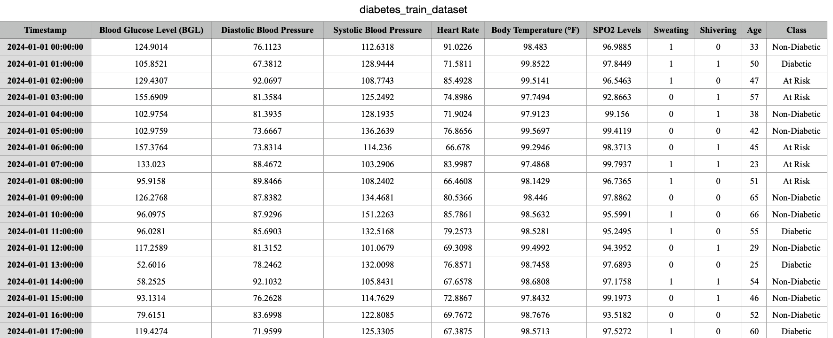
DATASET [1/2]
PREPROCESSED TRAINING DATA
kaggle.com

Slide 14
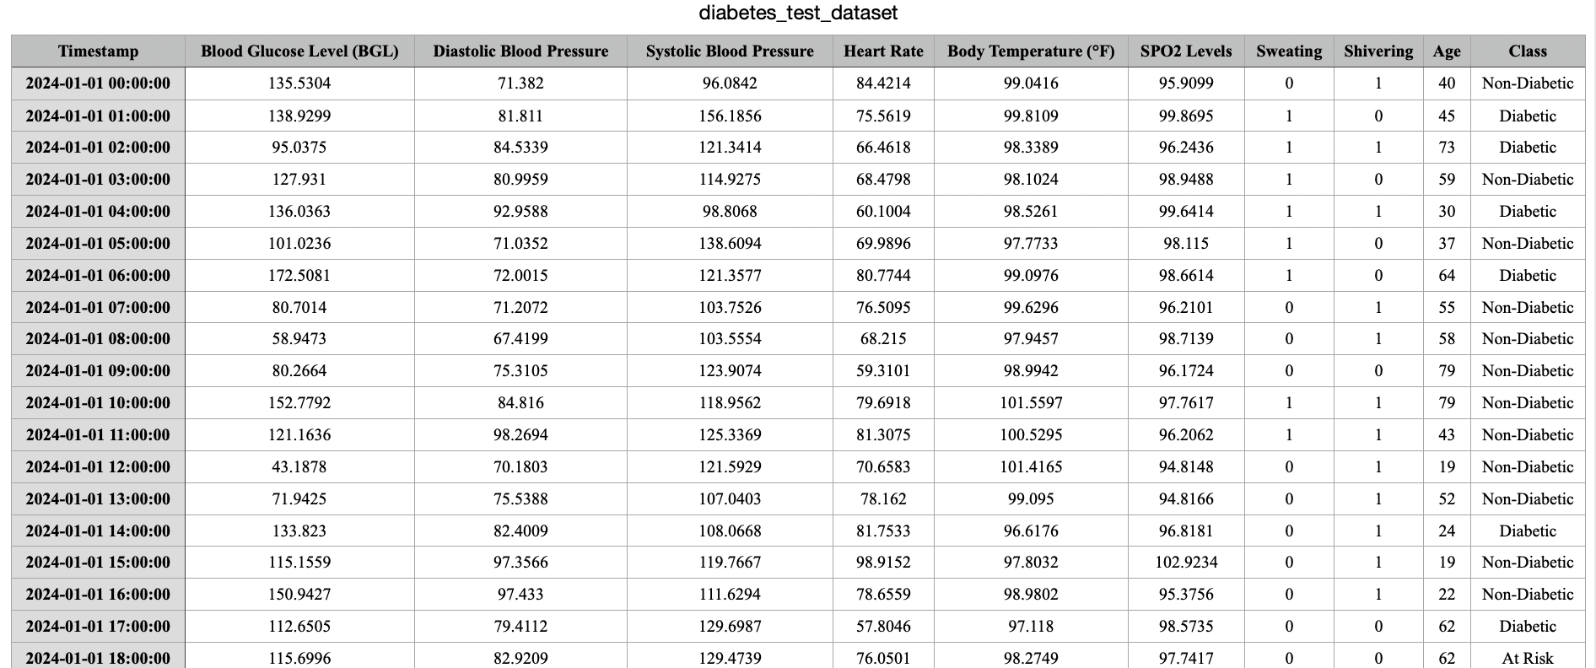
DATASET [2/2]
PREPROCESSED TESTING DATA

Slide 15
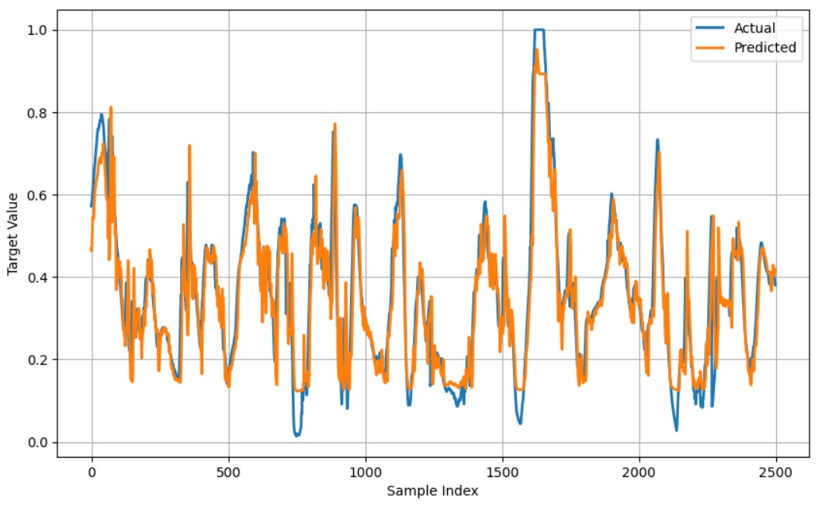
RESULTS [1/8]
Comparison of Actual Vs Predicted Blood Glucose Level

Slide 16
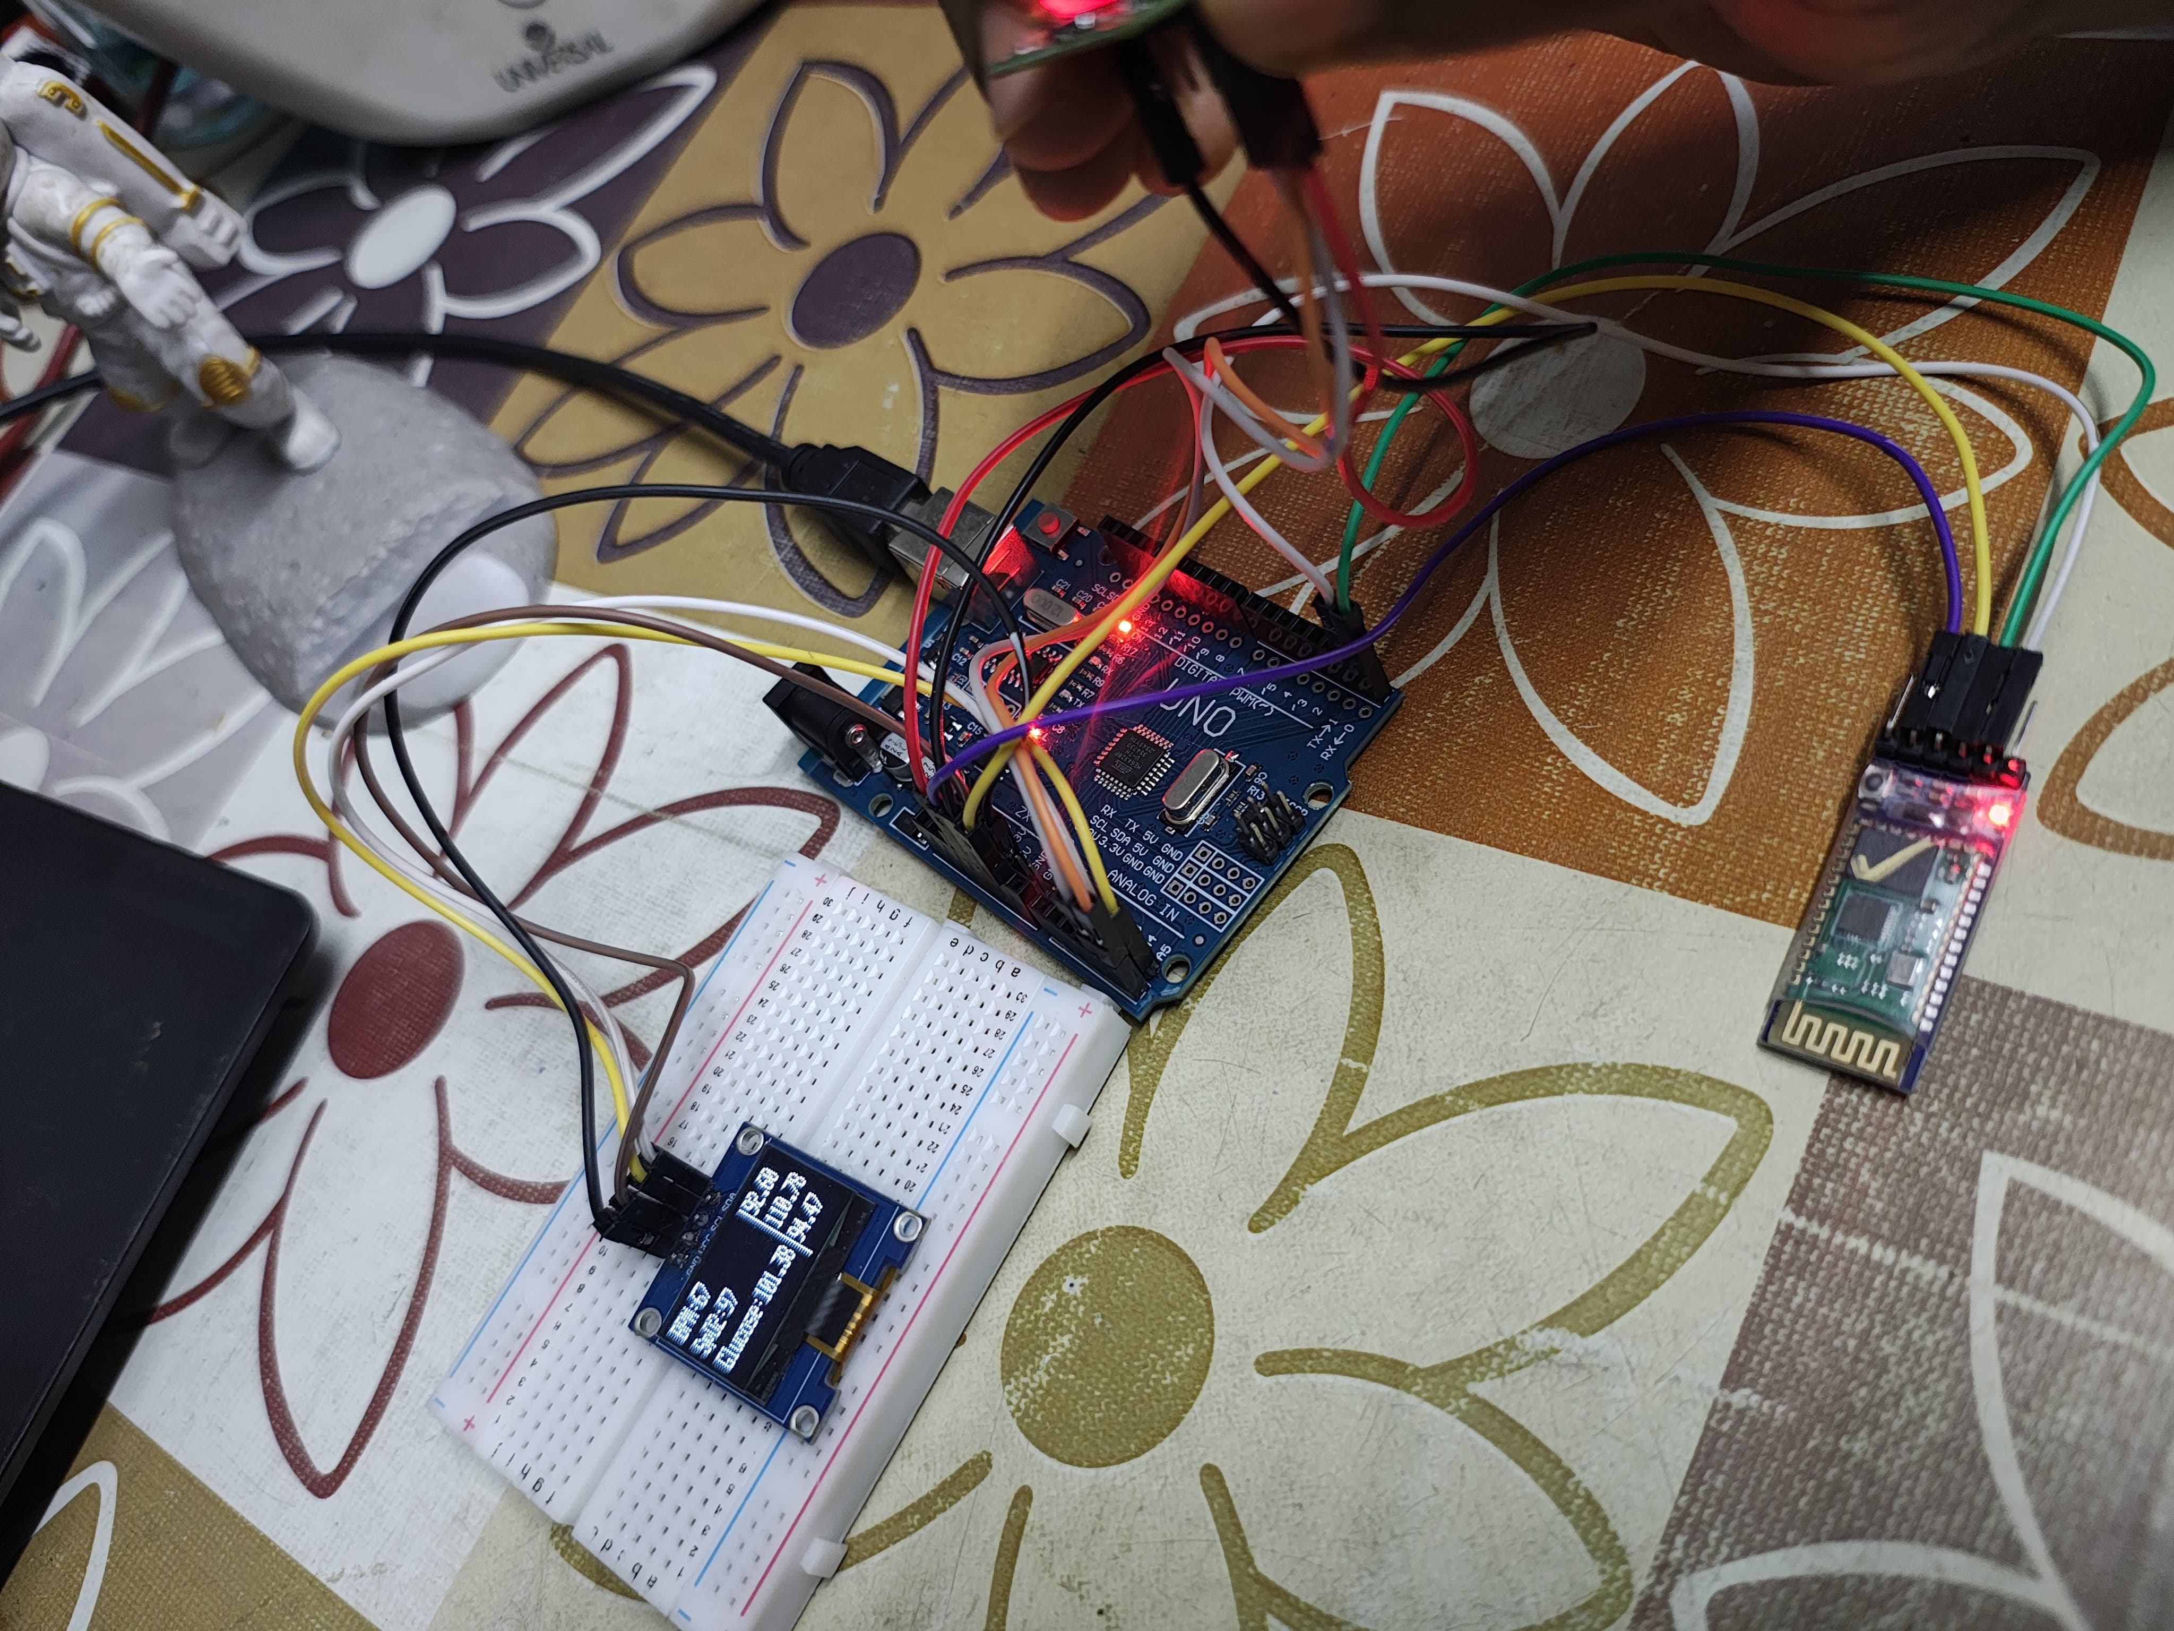
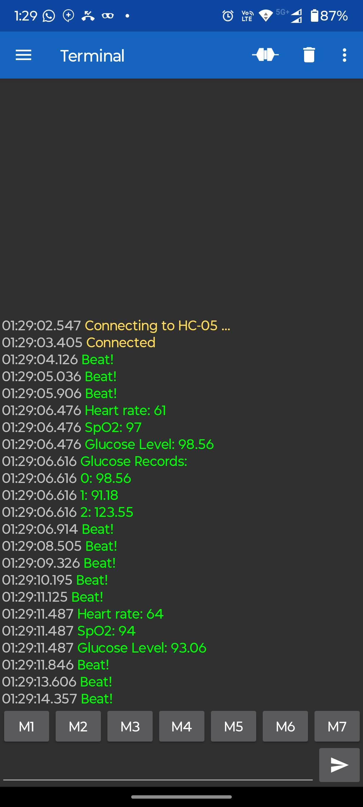
RESULTS [2/8]
Hardware
Values from the sensor on the app

Slide 17
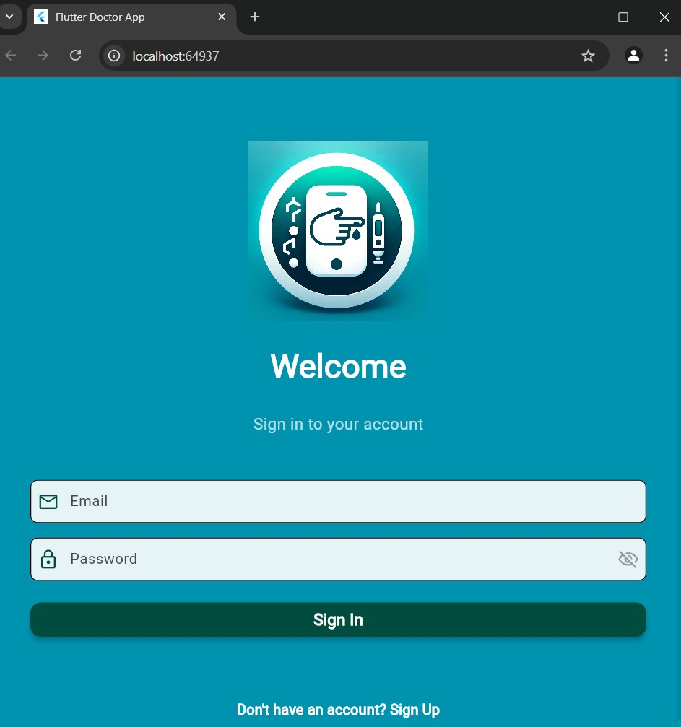
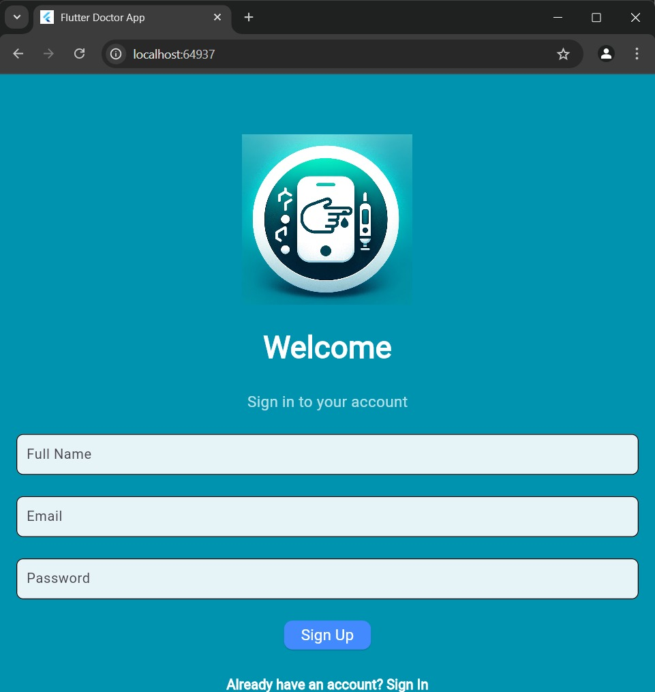
RESULTS [3/8]
Sign In page
Sign Up page

Slide 18
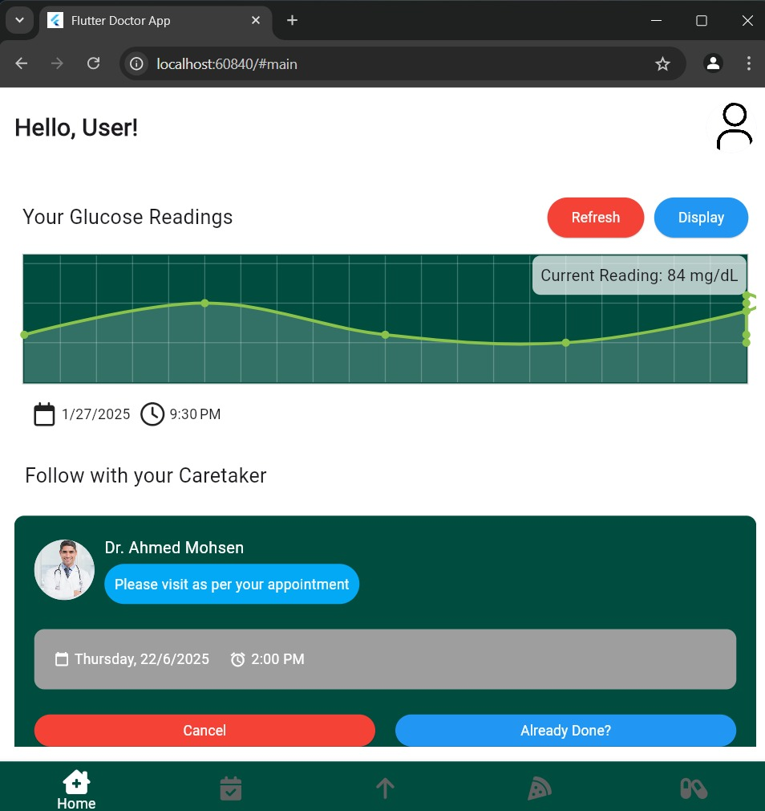
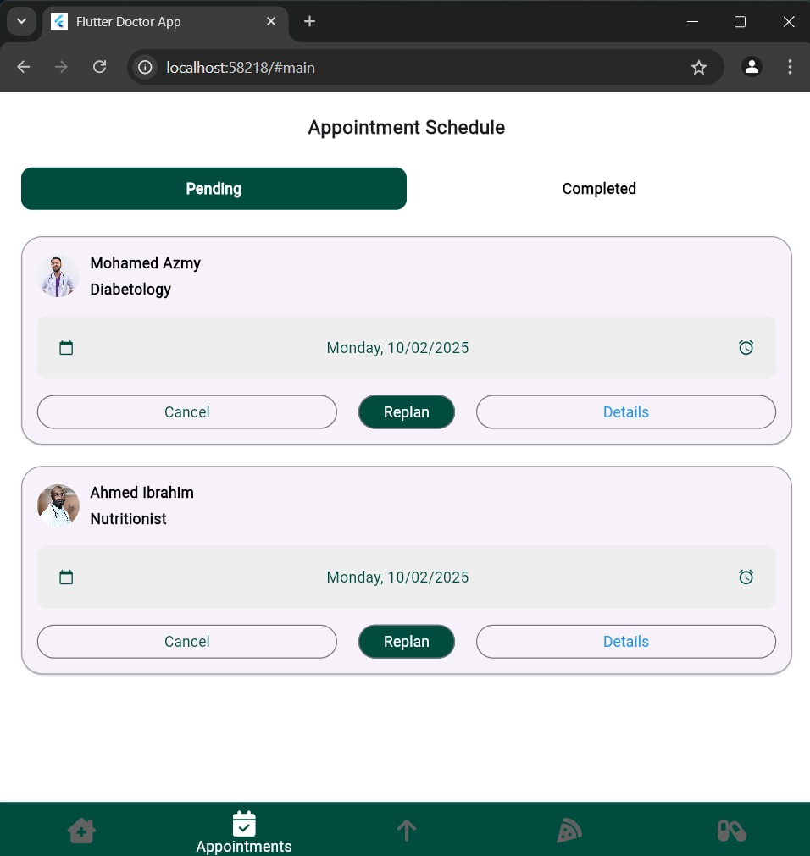
RESULTS [4/8]
User Dashboard
Appointment Scheduling for Diabetes Management

Slide 19
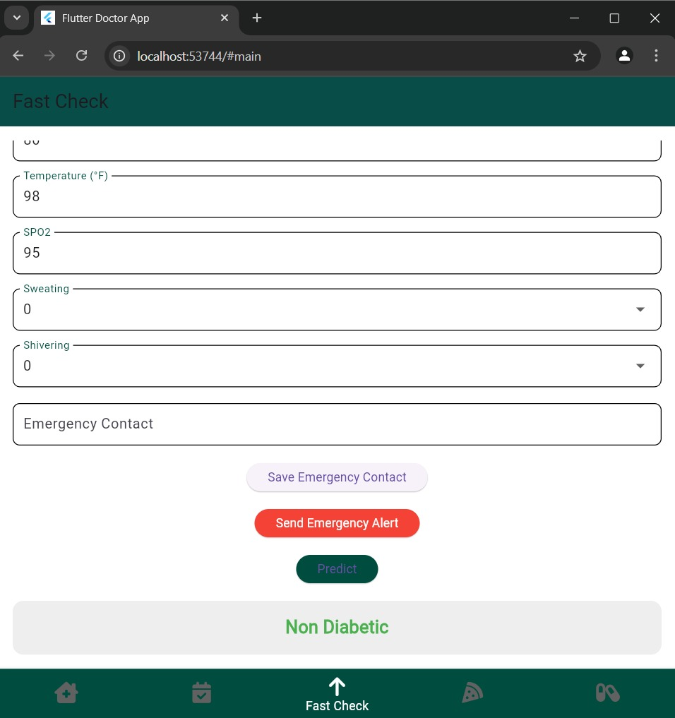
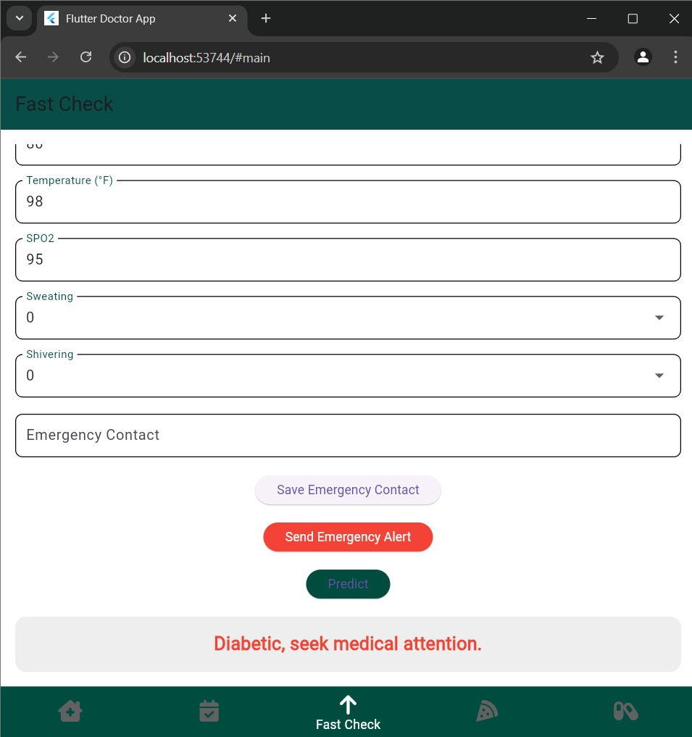
RESULTS [5/8]
Based on User Health Parameters Showing Non-Diabetes
Based on User Health Parameters Showing Diabetes

Slide 20
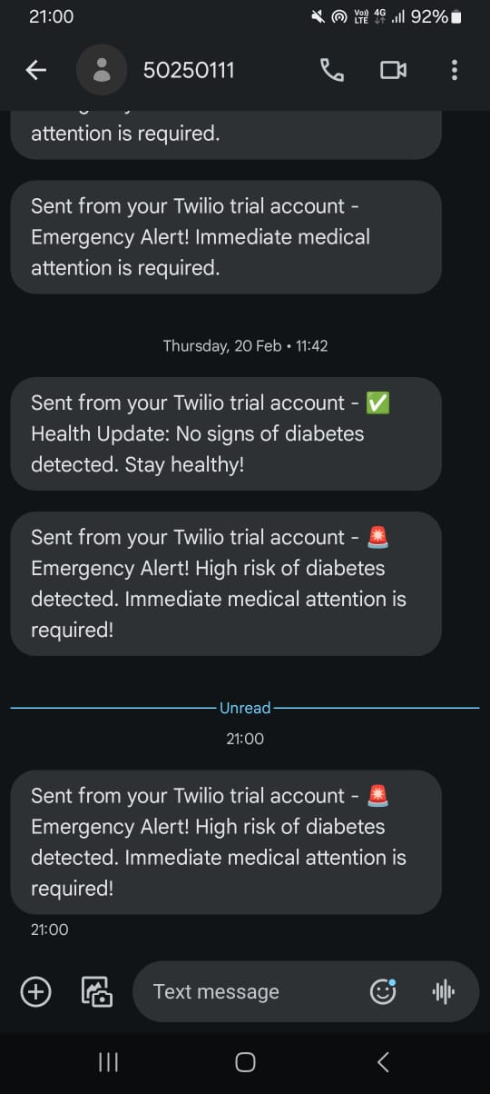
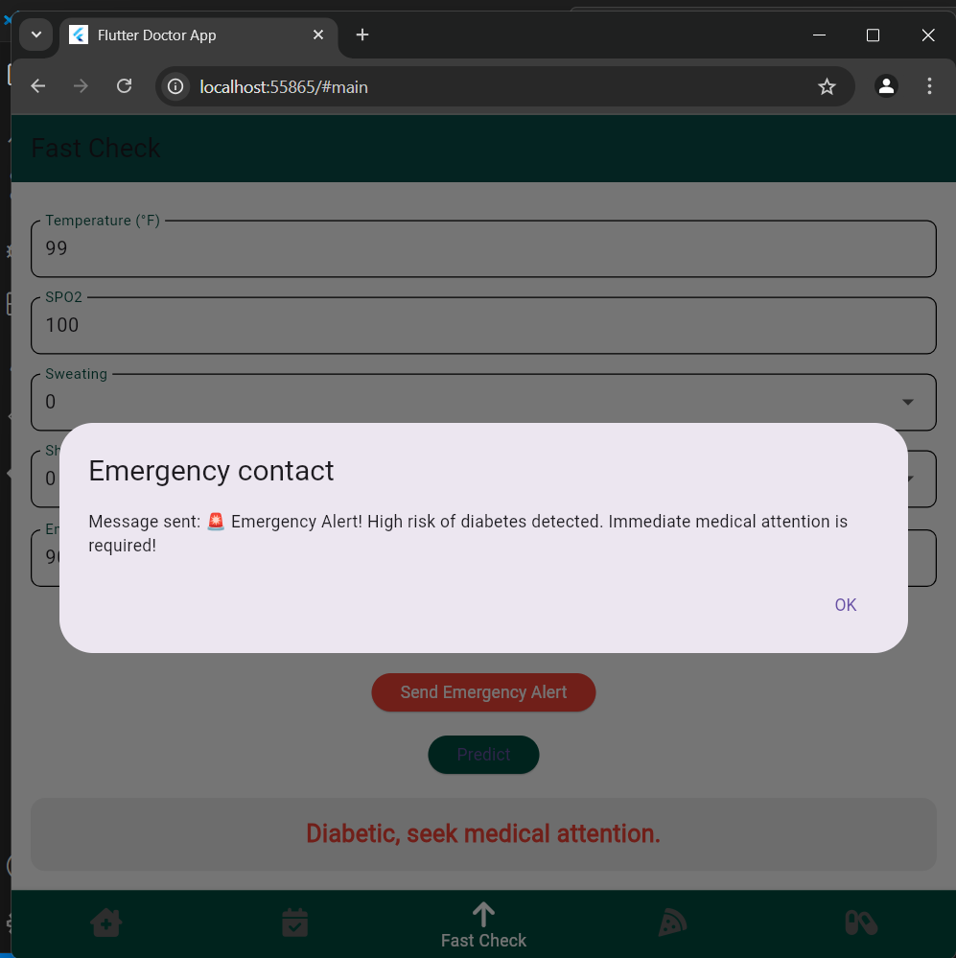
RESULTS [6/8]
Emergency Alert Notification
Automated Diabetes Alert System via Twilio

Slide 21
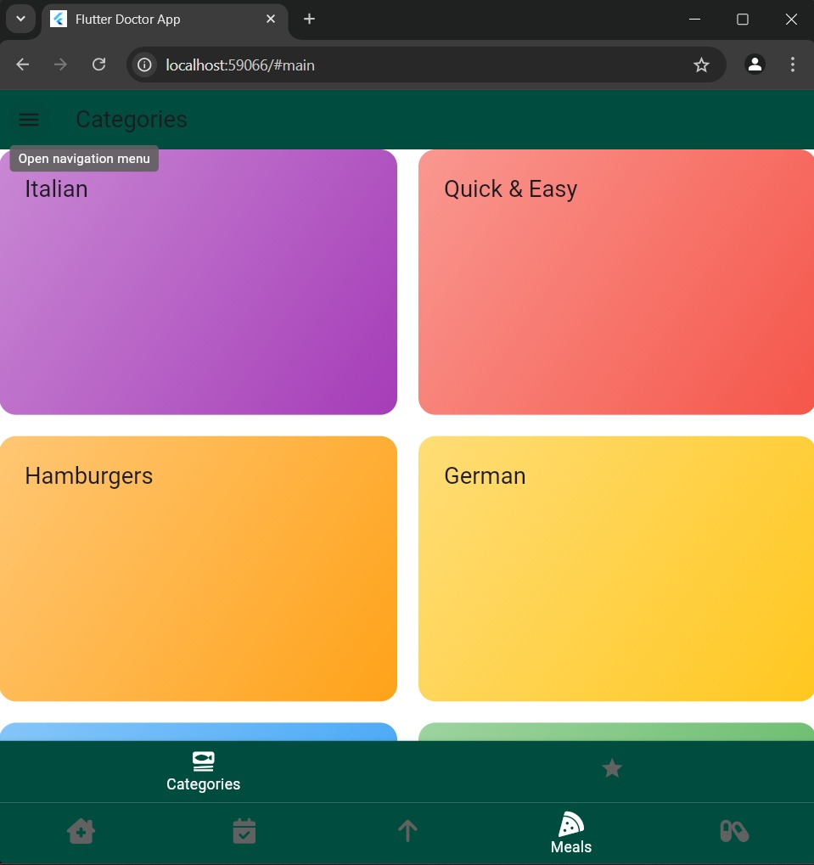

RESULTS [7/8]
Personalized Meal Plan Categories
Recommended Meal Options

Slide 22
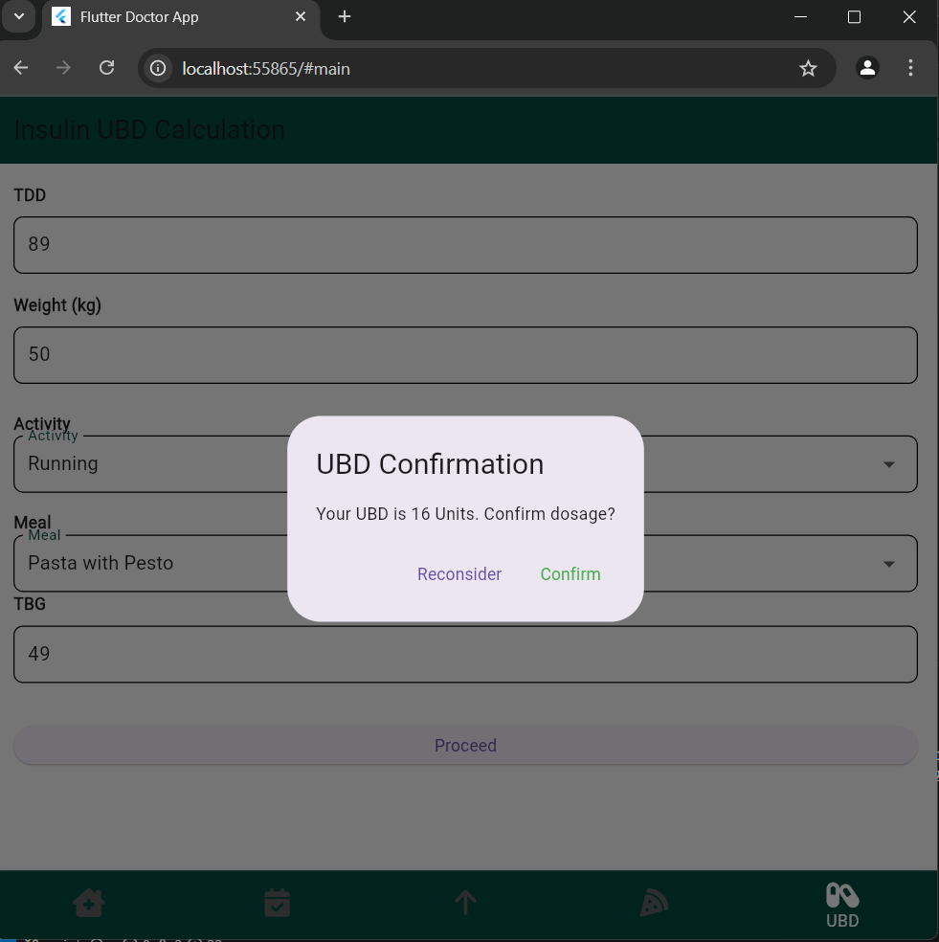
RESULTS [8/8]
UBD Confirmation Prompt for Insulin Dosage

Slide 23
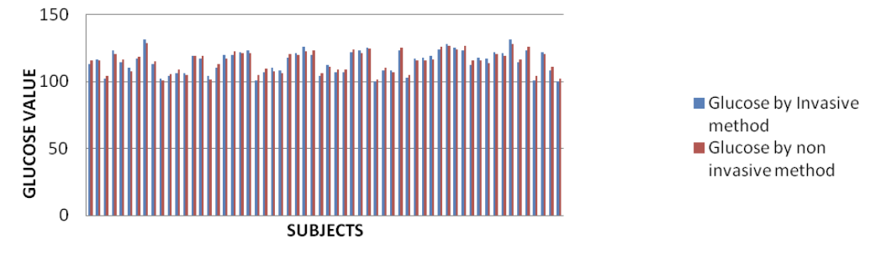
CONCLUSION
Developed a system for predicting diabetic conditions based on health data inputs.
Achieved 94.62% model accuracy using LSTM in comparison with [1] Medibuddy Smart Disease Predicton: Decision Tree Models: Attained an accuracy of 91.87% in predicting diabetes and prediabetes and [2] Advisor Pro by Dreamed Diabetes accuracy in predicting in diabetes: Artificial Neural Networks (ANNs): Achieved an accuracy of 80% in predicting diabetes progression
Hardware :
Comparison of blood glucose measurement
Implementation of blood Glucose and cholesterol monitoring device using non-invasive technique

Slide 24
THANK YOU

Slide 25
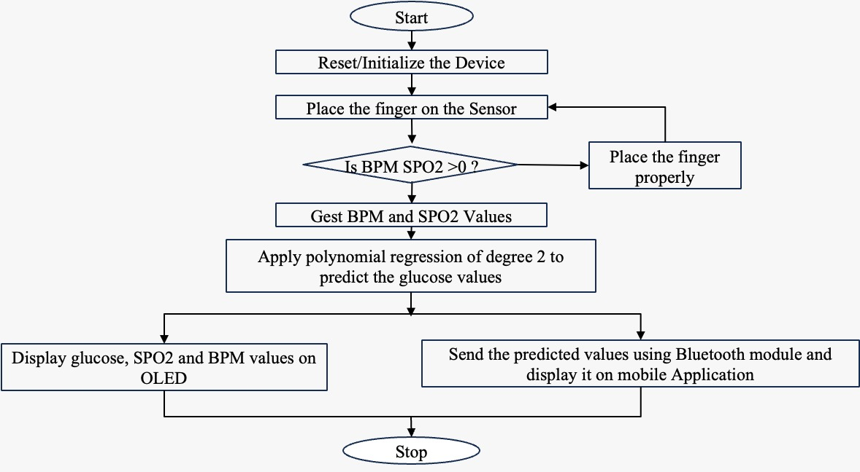
No
,
Yes
Gets BPM & SO2 values

Slide 26
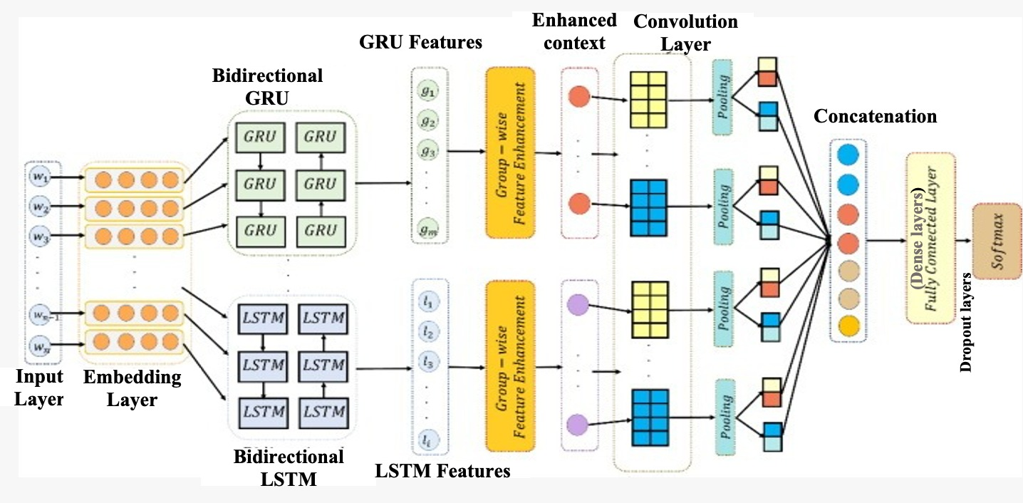
sciencedirect.com

Slide 27
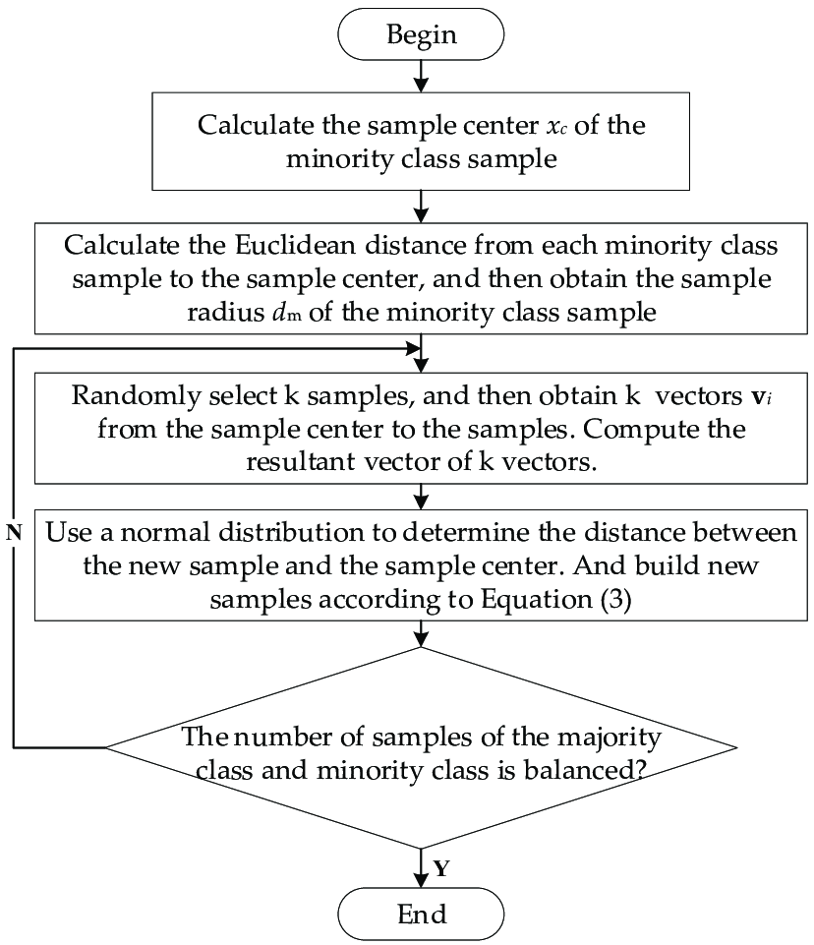
www.researchgate.net

